Slide 1
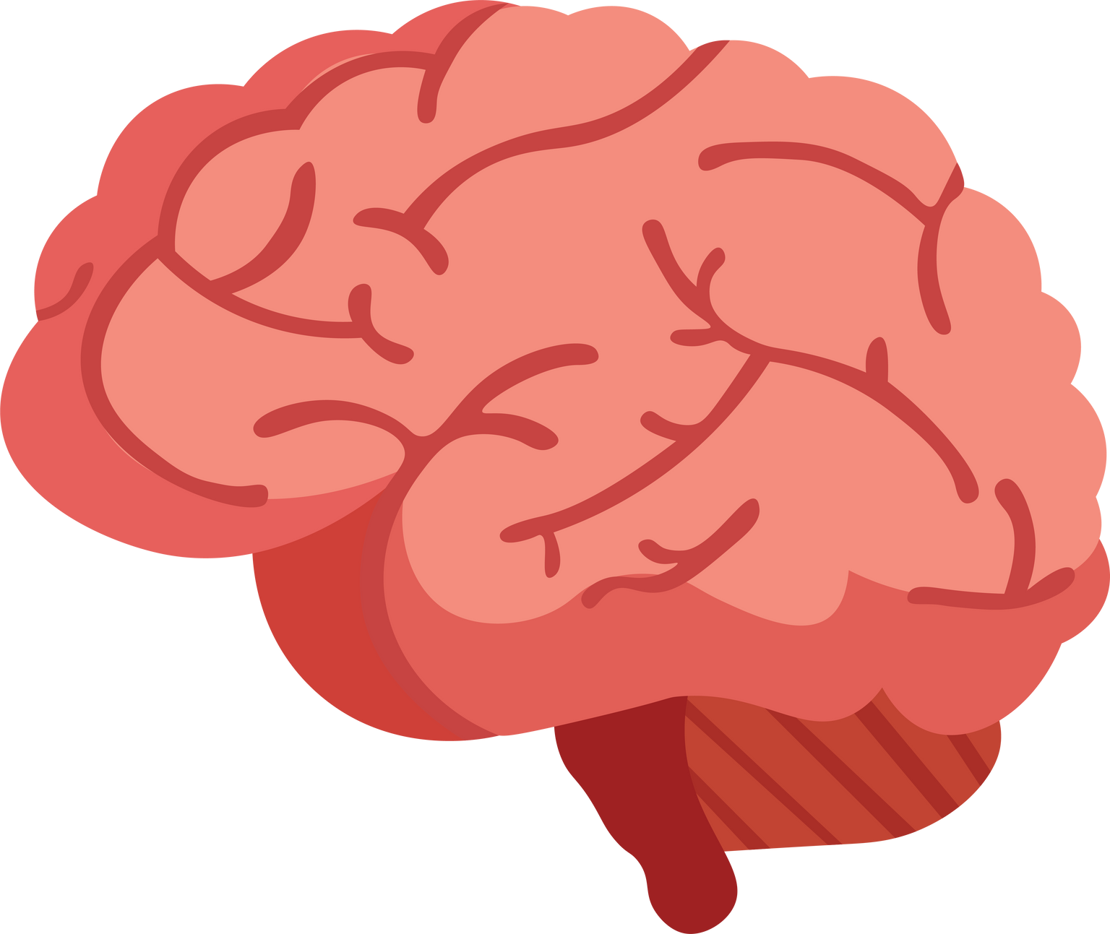



The study of relationships between positive and negative environmental sounds which affect state anxiety and emotional-attention processing.
PRESENTED BY
1. KRITPATCHARA WONGKWAN 65010004 5C
2. NUTTANIT TREEVIJITPAISAN 65010017 5S
3. WATSANANON WONGSURIN 65010059 5C
ADVISOR
1. DR. THITAPORN CHAISILPRUNGRAUNG
2. ASST.PROF.DR. SIRAWAJ ITTHIPURIPAT
3. MISS JINTANA WONGTA
DARUNSIKKHALAI SCIENCE SCHOOL
KING MONGKUT’S UNIVERSITY OF TECHNOLOGY THONBURI
Notes:
ทุกคนอาจเคยได้ยินกันมาบ้างว่าคนที่มีอารมณ์ดี หน้าตายิ้มแย้มแจ่มใส มักจะทำงานได้มีประสิทธิภาพมากกว่าคนที่อารมณ์ไม่ดี ชอบทำหน้าบึ้งตึง แล้วทุกคนสงสัยกันไหมคะว่าอารมณ์เกี่ยวข้องกับประสิทธิภาพในการทำงานอย่างไร และสภาพแวดล้อมรอบๆตัวเรามีความสัมพันธ์กับประสิทธิภาพในการทำงานอย่างไร วันนี้เราจะมาหาคำตอบกัน
สวัสดีค่ะวันนี้พวกเราจะมานำเสนอโครงงานเรื่อง การศึกษาความสัมพันธ์ระหว่างเสียงในสภาพแวดล้อมกับการประมวลผลทางอารมณ์และสมาธิ โดยสมาชิกในกลุ่มมี
ดิฉัน นางสาวณัฏฐนิจ ตรีวิจิตรไพศาล
/ผายมือไปที่กระวาน/ นายกฤษพัชร วงศ์ขวัญ
และ นายวสนานนท์ วงศ์สุรินทร์
โดยมีที่ปรึกษาคือ
ดร.ฐิตาภรณ์ ฉายศิลป์รุ่งเรือง
ผู้ช่วยศาสตราจารย์ ดร. ศิรวัจน์ อิทธิภูริพัฒน์
และ อาจารย์จินตนา วงศ์ต๊ะ

Slide 2
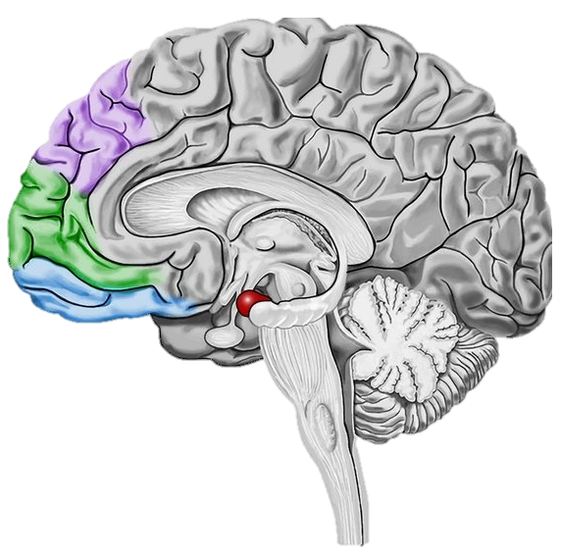
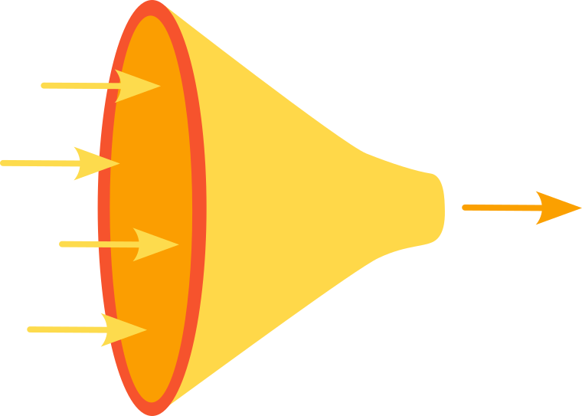
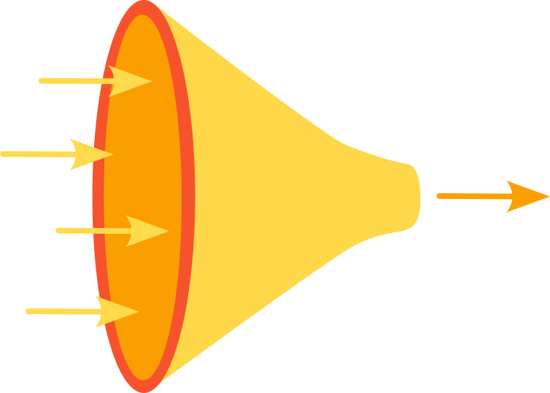
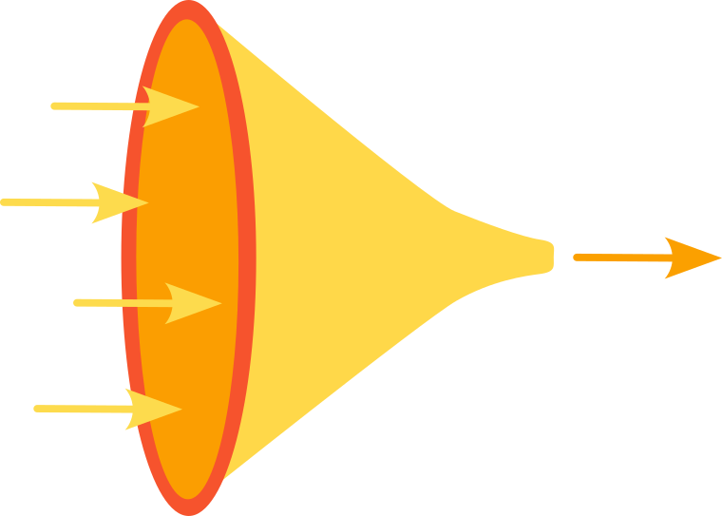
INTRODUCTION
1
Attention
Emotion
Selective attention = filtering
- Processed by Amygdala
Emotional valence
Effects
- Positive
Attention field
- Negative
“Emotional-attention processing”
(Aletta, et al., 2021)
(MentalUP, 2022)
(Zhang et al., 2016)
Positive emotion
Broadened attention field
Negative emotion
Narrowed attention field

Slide 3
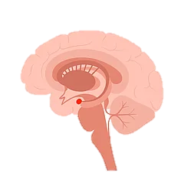
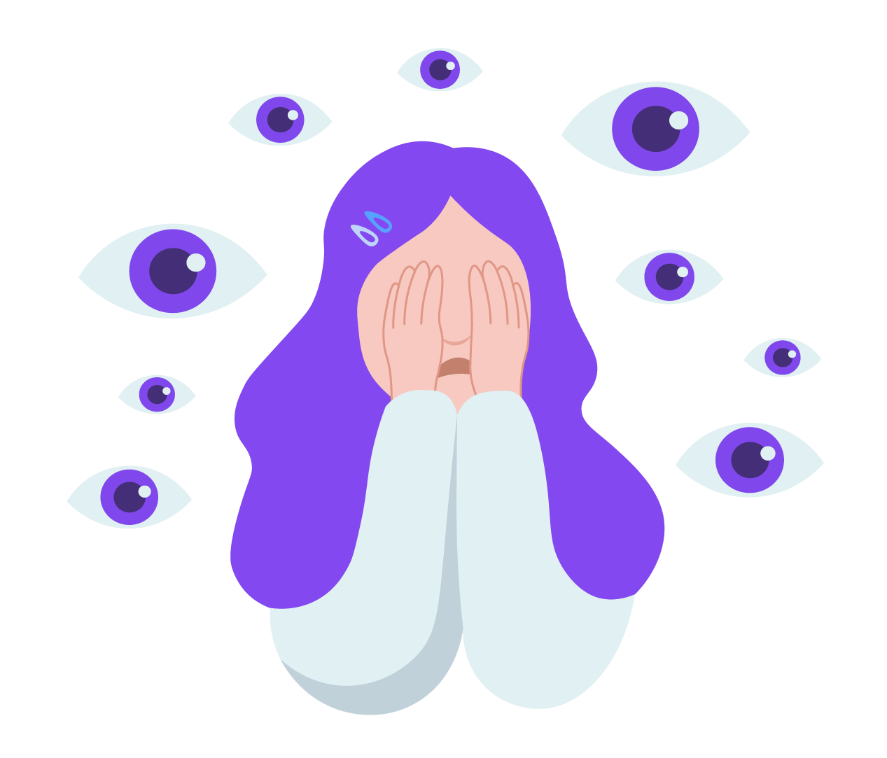




RESEARCH QUESTION
2
(Bishop et al., 2008)
(Standing et al., 1980)
(Zhang et al., 2016)
Environmental sound
State anxiety
Emotional-attention processing
Amygdala
?
OBJECTIVE
“ TO STUDY RELATIONS BETWEEN ENVIRONMENTAL SOUND AND EMOTIONAL-ATTENTION PROCESSING ”

Slide 4


HYPOTHESIS
3
Positive sound results in a broader attention field for emotional-attention processing.
Negative sound results in a narrowing attention field for emotional-attention processing.
v
Positive sound
Broadened attention field
Negative sound
Narrowed attention field
EXPECTED RESULTS
Understanding of the relationships between environmental sound and emotional-attention processing.
Can be applied to commercial products (Neuromarketing).
Notes:
Positive sound result in a broader scope for emotional-attention processing.
Negative sound result in a narrowing

Slide 5






METHODOLOGY
4
PARTICIPANT RECRUITMENT
QUESTIONNAIRE
STAI:
state anxiety before & after the Flanker task
PN (15)
DASS-21:
negative emotional state
18 Participants
30 Participants
NP (15)
EXPERIMENTAL DAY
1st
Flanker task
2nd
Flanker task
1st STAI
2nd STAI
3rd STAI
4th STAI
Break
15 mins
15 mins
15 mins
Experimentation
Flanker task
Data analysis

Slide 6

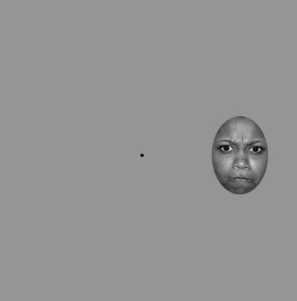

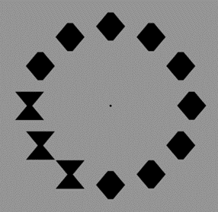




FLANKER TASK
5
Emotional face
Congruence
Focus point
Diamond
Hourglass
Congruent
Incongruent
Correct
Incorrect
Time out
Experimentation
Flanker task
Data analysis

Slide 7
6
STAI score
STAI Form Y-1 was used to measure state anxiety before and after the Flanker task.
STAI scores vary according to the level of anxiety.
1st STAI
1st
Flanker task
2nd STAI
3rd STAI
2nd
Flanker task
Break
4th STAI
Compared
Compared
Paired sample t-test:
Compares the two STAI scores, one taken before and one after the Flanker task.
P < 0.05
Significantly different
Experimentation
Flanker task
Data analysis

Slide 8
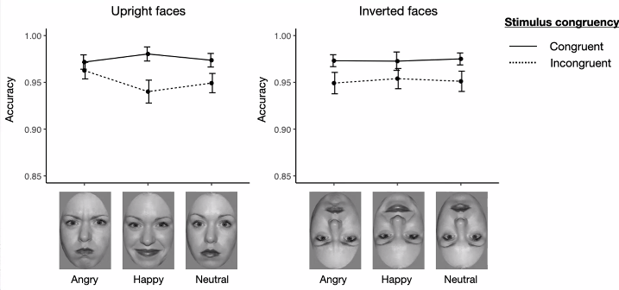

7
HIT RATE & RESPONSE TIME
Data from the Flanker task in .csv format, to be analyzed in the R program.
Graph:
Shows the relationship between 1) Hit rate and emotional stimuli, and 2) Response time and emotional stimuli.
“Congruent”
Hit rate
“Incongruent”
Angry
Happy
Neutral
Experimentation
Flanker task
Data analysis

Slide 9
8
STAI score results (n = 30)
Paired sample t-test:
Positive sounds significantly decrease anxiety levels, while negative sounds significantly increase them.
Mean score:
Before = 37.83
P = 4.90x10⁻³, t = 3.04
After = 31.83
Mean score:
Before = 33.13
P = 3.71 x 10⁻⁶, t = -5.69
After = 47.87
Because p < 0.05, both are significantly different.

Slide 10
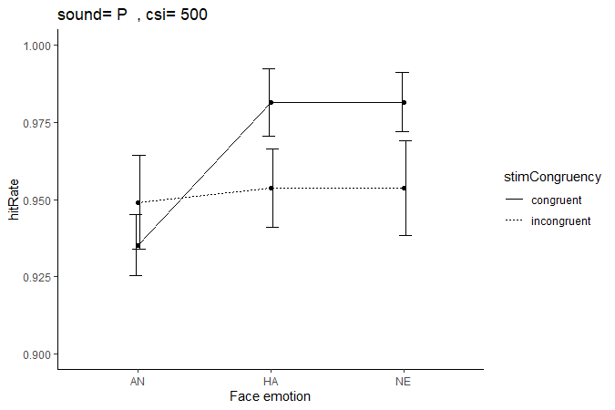
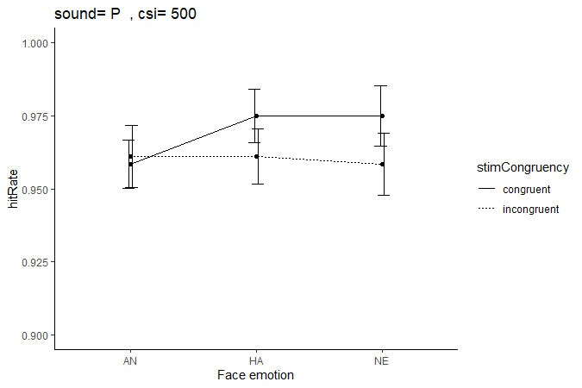

POSITIVE SOUND HIT RATE GRAPH
9
18 participants
30 participants
Angry
Happy
Neutral
Angry
Happy
Neutral
Fig 1. Relationship between hit-rate and emotional stimuli in positive sound

Slide 11
POSITIVE SOUND HIT RATE GRAPH
10
18 participants
30 participants
Angry
Happy
Neutral
Angry
Happy
Neutral
The trend in the average hit rate is increasing.

Slide 12
POSITIVE SOUND HIT RATE GRAPH
11
18 participants
30 participants
Angry
Happy
Neutral
Angry
Happy
Neutral
The trend in the average hit rate remains constant.

Slide 13
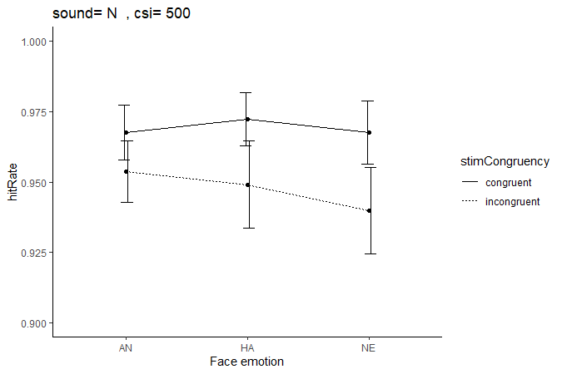
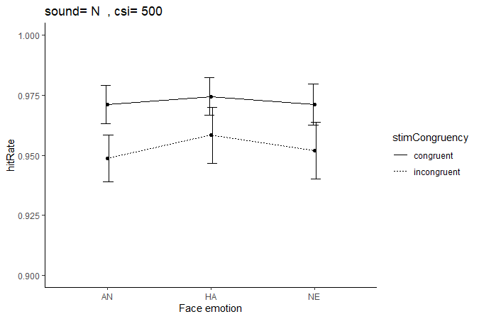
NEGATIVE SOUND HIT RATE GRAPH
12
18 participants
30 participants
Angry
Happy
Neutral
Angry
Happy
Neutral
Fig 2. Relationship between hit-rate and emotional stimuli in negative sound

Slide 14
NEGATIVE SOUND HIT RATE GRAPH
13
18 participants
30 participants
Angry
Happy
Neutral
Angry
Happy
Neutral
The trend in the average hit rate remains constant.

Slide 15
NEGATIVE SOUND HIT RATE GRAPH
14
18 participants
30 participants
Angry
Happy
Neutral
Angry
Happy
Neutral
The graph transitioned from a straight line to a V shape.

Slide 16


How to analyze graphs?
15
Congruence
Hit rate
Attention field
The size of the attention field is directly proportional to the hit rate.
Congruent
Hit rate
Attention field
The size of the attention field is inversely proportional to the hit rate.
Incongruent
Attention field
Difference in hit rate between congruence

Slide 17
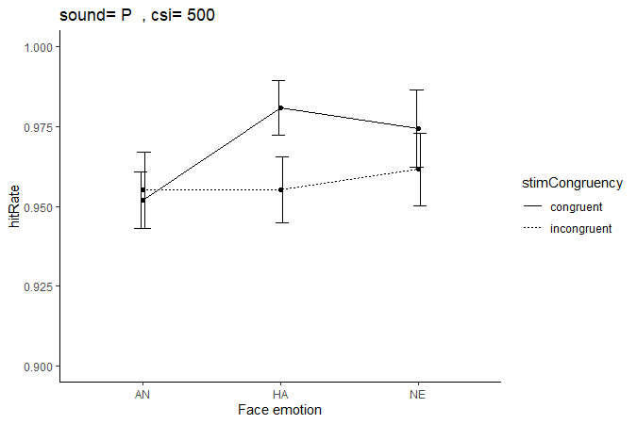
HIT RATE COMPARISON
16
Positive sound
Negative sound
Angry
Happy
Neutral
Angry
Happy
Neutral
Attention field of negative sound > positive sound

Slide 18
HIT RATE COMPARISON
17
Positive sound
Negative sound
Angry
Happy
Neutral
Angry
Happy
Neutral
Attention field of positive sound > negative sound

Slide 19
HIT RATE COMPARISON
18
Positive sound
Negative sound
Angry
Happy
Neutral
Angry
Happy
Neutral
Attention field of negative sound > positive sound

Slide 20



19
Do the results match the hypothesis?
1.) Sound affects state anxiety and emotional-attention processing.
2.) Positive sound results in a broader attention field but negative sound results in a narrowing attention field.
: from STAI score and shape of 2 graphs
: Only true when a happy face is the stimulus
Future Plan :
Identify the reason the results do not align with the hypothesis.

Slide 21
Thank you for your selective attention

Slide 22
References
Bishop, S.J., 2008, "Neural Mechanisms Underlying Selective Attention to Threat", Ann N Y Acad Sci, Vol. 1129, No., pp. 141-52.
Jouvent, R., Bungener, C., Morand, P., Millet, V., Lancrenon, S. and Ferreri, M., 1999, "[Distinction between Anxiety State/Trait in General Practice: A Descriptive Study]", Encephale, Vol. 25, No. 1, pp. 44-9.
Standing, L. and Stace, G., 1980, "The Effects of Environmental Noise on Anxiety Level", The Journal of General Psychology, Vol. 103, No. 2, pp. 263-272.
Zhang, X., Japee, S., Safiullah, Z., Mlynaryk, N. and Ungerleider, L.G., 2016, "A Normalization Framework for Emotional Attention", PLoS biology, Vol. 14, No. 11, p. e1002578.

Slide 23
APPENDIX

Slide 24
LITERATURE REVIEW
(Zhang et al., 2016)
(Aletta, et al., 2021)
“Emotional-attention processing”
Environmental Sound
(Bishop et al., 2008)
Positive sound
Negative sound
Anxiety
(Jouvent et al., 1999)
v
(Standing et al., 1980)
State anxiety
stressful situation
Trait anxiety
Decrease state anxiety
Increase
state anxiety
individual differences

Slide 25

SOUND SELECTION
Positive sound
Negative sound
Natural sound
Traffic sound
QUESTIONNAIRE
The Depression, Anxiety and Stress Scale (DASS-21)
State-Trait Anxiety Inventory (STAI)
measure the negative emotional states of depression, anxiety and stress.
using STAI Form Y-1
measure state anxiety before and after the Flanker task.
Notes:
Positive sound result in a broader scope for emotional-attention processing.
Negative sound result in a narrowing

Slide 26
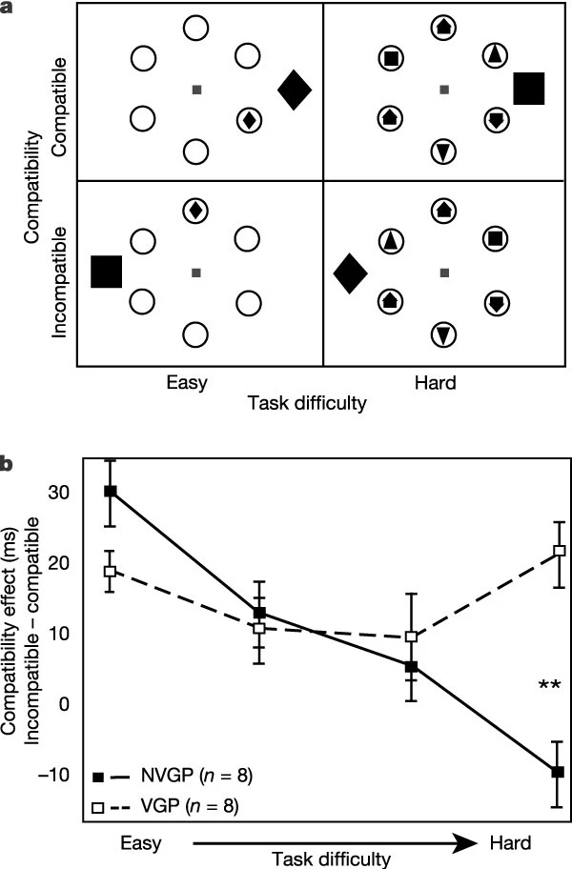
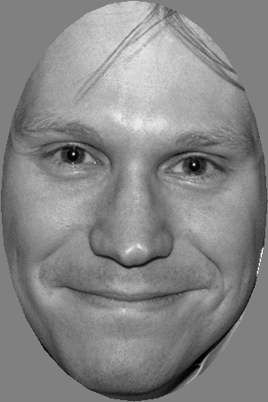
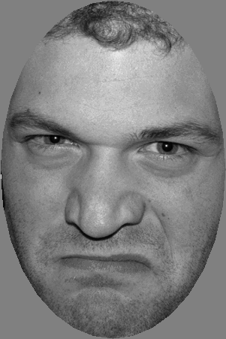
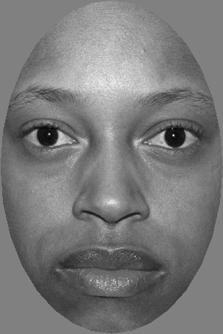
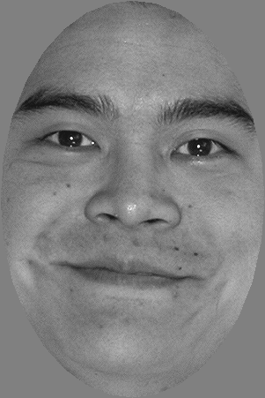
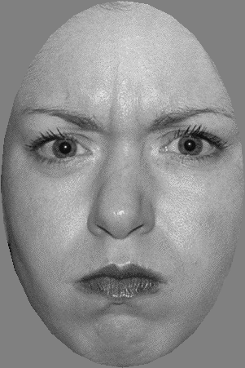
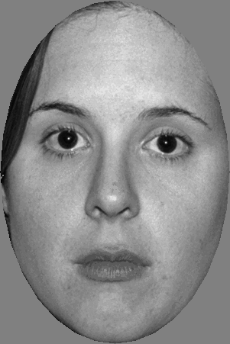
TASK Preparation
(Using MATLAB)
Flanker compatibility task
Facial expression stimuli
(Green and Bavelier, 2003)
(Tottenham et al., 2009)

Slide 27
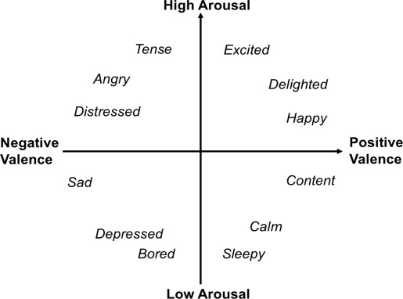
The circumplex model of emotion
(Russell, 1980)

Slide 28

FLANKER TASK
Emotional face
Diamond
Hourglass
Focus point
Correct
Incorrect
Time out

Slide 29


CONGRUENCE
Other components called “flanker”
Target
“Congruent”
Stimulus
Target
“Incongruent”
Stimulus

Slide 30
Flanker task condition
Trials:
3 x 2 x 12 x 2 = 144 trials
Emotion
Timing (csi)
X3
- 125 ms
X2
- 500 ms
Location
Congruence
X12
X2
Congruent
Incongruent
Notes:
Positive sound result in a broader scope for emotional-attention processing.
Negative sound result in a narrowing

Slide 31
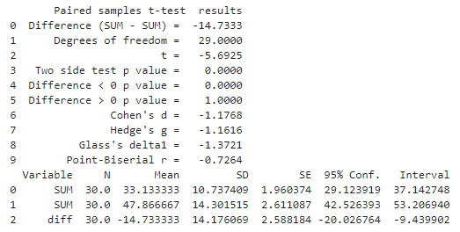
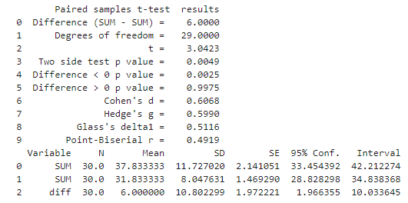
STAI score results (n = 30)
Paired sample t-test:
Positive sounds significantly decrease anxiety levels, while negative sounds significantly increase them.
Negative
Positive
file:///C:/Users/ROG/Downloads/Analyze.html
Result_STAI_DASS

Slide 32

%% Flanker task: Examining emotional attention effect across different env. sounds
%% Condition information
% Face cue:
% 1. Emotion x 3 (HA, AN, NE)
% 2. Location x 12
% 3. Timing x 2 (125/ 500 ms)
% Simulus (bowtie, diamond):
% 4. Congruency x 2 (con, incon)
% Note: congruency means 'aaaaa' and incongruency 'aabaa'
% Total number of condition: 3x12x2x2 = 144
% For each subject: 2 sound conditions (positive and negative)
% Total trials per subject: 144 x 2 = 288
% Number of face exemplars = 24 (each exemplar repeated 36 times; exemplars
% are not counterbalanced with other conditions)
% Note: exemplar selection ensures that each photo has >70% accuracy score,
% and that mean acc scores do not vary across emotions (HA, AN, NE/CA), and
% that emo level ratings do not differ across HA vs. AN categories
% actorID selected: 1 7 8 9 10 11 13 14 17 18 19 20 22 23 24 25 26 32 34 35 36 37 42 45
% (11F, 13M)
% Timing information
% 1. face cue = 0.075s
% 2. cue-stimulus-interval = 0.175s
% 3. stimulus = 1.55s
% 4. search duration = 2.05s (maximum)
% 5. feedback = 0.3s
% 6. inter-trial-interval = 1s
% estimated total time per trial = 0.75+0.175+1.55+2.05+0.3+1 = 5.15

Slide 33
